Slide 1
Data Link Layer
Prepared by
Divya K S
Adi shankara Institute of Engineering & Technology
Kalady

Slide 2
Data Link Layer Design Issues/Functionalities of DLL
Services Provided to the Network Layer
Framing
Error Control
Flow Control

Slide 3
Functions of the Data Link Layer
To accomplish the above goals DLL takes the packets it gets from the network layer and encapsulates them into frames for transmission.
Each frame contains a frame header, a payload field for holding the packet, and a frame trailer.
Frame management forms the heart of DLL

Slide 4
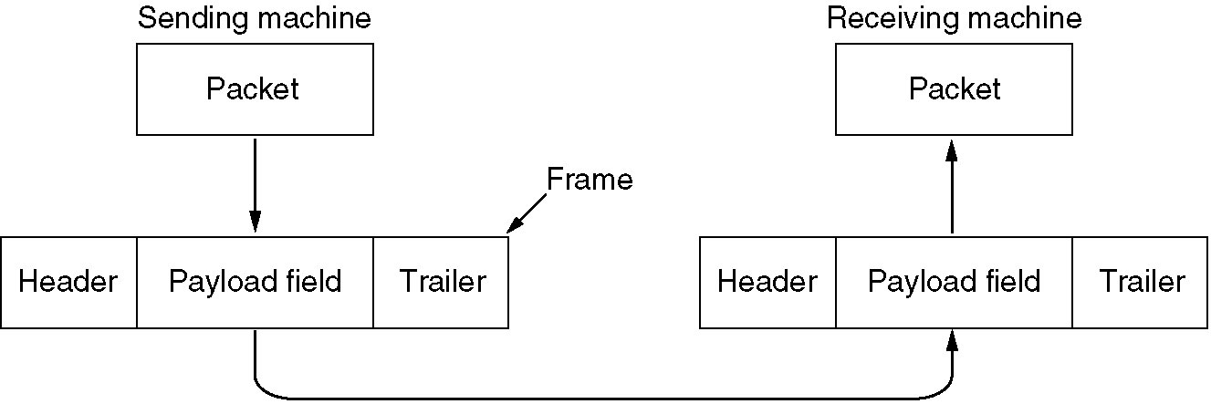
Relationship between packets and frames.

Slide 5
Services provided to the Network Layer
The function of the data link layer is to provide services to the network layer.
The principal service is transferring data from the network layer on the source machine to the network layer on the destination machine

Slide 6
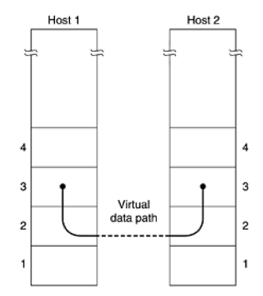
Services provided to the Network Layer
The job of the data link layer is to transmit the bits to the destination machine so they can be handed over to the network layer there,
Virtual Communication

Slide 7
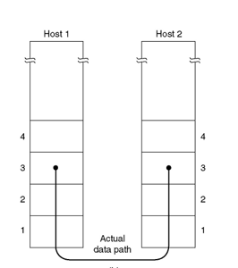
Services provided to the Network Layer
The actual transmission follows the Path as shown below
Actual Communication.

Slide 8
Services provided to the Network Layer
DLL commonly provides 3 services
Unacknowledged connectionless service
Acknowledged connectionless service
Acknowledged connection-oriented service

Slide 9
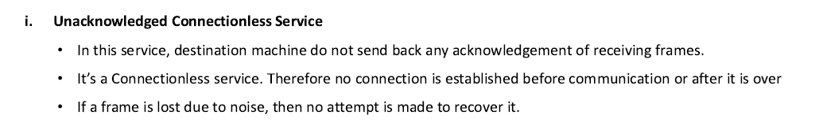
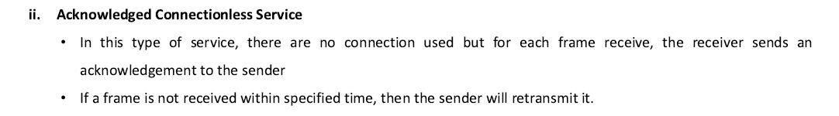

Slide 10
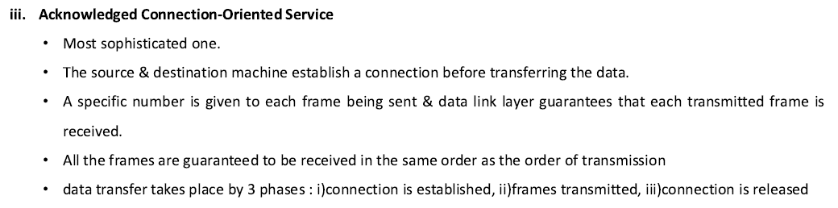

Slide 11
Framing
Data-link layer takes the packets from the Network Layer and encapsulates them into frames.
If the frame size becomes too large, then the packet may be divided into small sized frames.
Smaller sized frames makes flow control and error control more efficient.
Then, it sends each frame bit-by-bit on the hardware. At receiver’s end, data link layer picks up signals from hardware and assembles them into frames.
Process of breaking down a stream of bits into smaller, manageable units called frames

Slide 12
Framing
To provide service to the network layer, the data link layer must use the service provided to it by the physical layer.
What the physical layer does is accept a raw bit stream and attempt to deliver it to the destination.
This bit stream is not guaranteed to be error free.
The number of bits received may be less than, equal to, or more than the number of bits transmitted, and they may have different values.
It is up to the data link layer to detect and, if necessary, correct errors.

Slide 13
Framing
The usual approach is for the data link layer to break the bit stream up into discrete frames and compute the checksum for each frame.
When a frame arrives at the destination, the checksum is recomputed.
If the newly-computed checksum is different from the one contained in the frame, the data link layer knows that an error has occurred and takes steps to deal with it (e.g., discarding the bad frame and possibly also sending back an error report).

Slide 14
Framing- Types
Framing can be of two types
Fixed-sized Framing
Variable – Sized Framing

Slide 15
Framing- Types
Framing can be of two types, fixed sized framing and variable sized framing.
Fixed-sized Framing
Here the size of the frame is fixed and so the frame length acts as delimiter of the frame.
Consequently, it does not require additional boundary bits to identify the start and end of the frame.
Example − ATM cells.
Variable – Sized Framing
Here, the size of each frame to be transmitted may be different.
So additional mechanisms are kept to mark the end of one frame and the beginning of the next frame.

Slide 16
Framing
One way to achieve this framing is to insert time gaps between frames, much like the spaces between words in ordinary text.
However, networks rarely make any guarantees about timing, so it is possible these gaps might be squeezed out or other gaps might be inserted during transmission.

Slide 17
Methods of Framing
1. Character count.
2. Flag bytes with byte stuffing.
3. Starting and ending flags, with bit stuffing.
4. Physical layer coding violations.

Slide 18
Character count.
Uses a field in the header to specify the number of characters in the frame.
When the data link layer at the destination sees the character count, it knows how many characters follow and hence where the end of the frame is

Slide 19
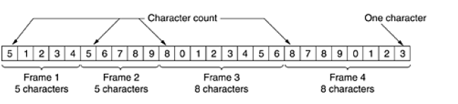
Character count.
Without errors

Slide 20
Character count
The trouble with this method is that the count can be garbled by a transmission error.
For example, if the character count of 5 becomes a 7, the destination will get out of synchronization and will be unable to locate the start of the next frame
For this reason, the character count method is rarely used anymore.

Slide 21
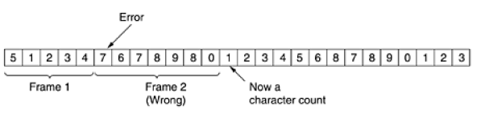
Character count -With one error.

Slide 22

Flag bytes with byte stuffing
The problem with character count can be overcome by this method.
In this method each frame start and end with special bytes called FLAG byte as shown below
if the receiver ever loses synchronization, it can just search for the flag byte to find the end of the current frame.
Two consecutive flag bytes indicate the end of one frame and start of the next one.

Slide 23
Flag bytes with byte stuffing
A serious problem occurs with this method when binary data, such as object programs or floating-point numbers, are being transmitted.
It may easily happen that the flag byte's bit pattern occurs in the data.
This situation will usually interfere with the framing.
One way to solve this problem is to have the sender's data link layer insert a
special escape byte (ESC) just before each ''accidental'' flag byte in the data.
The data link layer on the receiving end removes the escape byte before the data are given to the network layer.
This technique is called byte stuffing or character stuffing.
Thus, a framing flag byte can be distinguished from one in the data by the absence or presence of an escape byte before it.

Slide 24
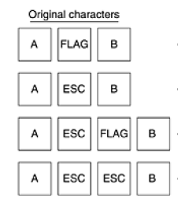
Flag bytes with byte stuffing

Slide 25
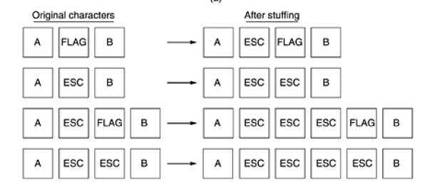
Four examples of byte sequences before and after stuffing.

Slide 26
Framing
Flag bytes with byte stuffing
If an escape byte occurs in the middle of the data, it is also stuffed with an escape byte.
Thus, any single escape byte is part of an escape sequence, whereas a doubled one indicates that a single escape occurred naturally in the data
Application:
Used in PPP (point-to-point protocol)
most home computers use PPP to communicate with their Internet service provider
Disadvantage of this framing method
it is closely tied to the use of 8-bit characters
Not all character codes use 8-bit characters.
UNICODE uses 16-bit characters

Slide 27
Problem : fixed character size : assumes character size to be 8 bits : can’t handle heterogeneous environment.

Slide 28
Starting and ending flags, with bit stuffing
technique allows data frames to contain an arbitrary number of bits and allows character codes with an arbitrary number of bits per character.
Each frame begins and ends with a special bit pattern, 01111110 (in fact, a flag byte).
Whenever the sender's data link layer encounters five consecutive 1s in the data, it automatically stuffs a 0 bit into the outgoing bit stream. This bit stuffing is analogous to byte stuffing, in which an escape byte is stuffed into the outgoing character stream before a flag byte in the data

Slide 29
Starting and ending flags, with bit stuffing
When the receiver sees five consecutive incoming 1 bits, followed by a 0 bit, it automatically destuffs (i.e., deletes) the 0 bit.
Just as byte stuffing is completely transparent to the network layer in both computers.
With bit stuffing, the boundary between two frames can be unambiguously recognized by the flag pattern.
Thus, if the receiver loses track of where it is, all it has to do is scan the input for flag sequences,
since they can only occur at frame boundaries and never within the data

Slide 30


Starting and ending flags, with bit stuffing-Example
(a) The original data.
(b) The data as they appear on the line.
(c) The data as they are stored in the receiver's memory after destuffing

Slide 31
Physical layer coding violations
only applicable to networks in which the encoding on the physical medium contains some redundancy
Eg: some LANs encode 1 bit of data by using 2 physical bits.
Normally, a 1 bit is a high-low pair and a 0 bit is a low-high pair.
The scheme means that every data bit has a transition in the middle, making it easy for the receiver to locate the bit boundaries.
The combinations high-high and low-low are not used for data but are used for delimiting frames in some protocols

Slide 32
Error Control
To make sure all frames are eventually delivered to the network layer at the destination and in the proper order
The usual way to ensure reliable delivery is to provide the sender with some feedback about what is happening at the other end of the line
For reliable delivery, protocol calls for the receiver send back special control frames bearing positive or negative acknowledgements about the incoming frames
If the sender receives a positive acknowledgement about a frame, it knows the frame has arrived safely.
On the other hand, a negative acknowledgement means that something has gone wrong, and the frame must be transmitted again

Slide 33
Error Control
Problem:
hardware troubles may cause a frame to vanish completely (e.g., in a noise burst).
In this case, the receiver will not react at all, since it has no reason to react.
Thus sender transmits a frame and then waits for an acknowledgement, positive or negative, will hang forever if a frame is ever lost
Solution:
by introducing timers into the DLL

Slide 34
Error Control
Use of Timer in DLL
When the sender transmits a frame, it generally also starts a timer.
The timer is set to expire after an interval long enough for the frame to reach the destination, be processed there, and have the acknowledgement propagate back to the sender.
acknowledgement will get back before the timer runs out
in which case the timer will be canceled
if either the frame or the acknowledgement is lost, the timer will go off, alerting the sender to a potential problem.
The obvious solution is to just transmit the frame again

Slide 35
Error Control
Use of Timer in DLL
Another Problem : receiving frames multiple times
Solution:
to assign sequence numbers to outgoing frames, so that the receiver can distinguish retransmissions from originals

Slide 36
Flow Control
Mechanisms used to prevent a fast sender from overloading a slow receiver with data
This situation occurs when the sender is running on a fast (or lightly loaded) computer and the receiver is running on a slow (or heavily loaded) machine.
The sender keeps pumping the frames out at a high rate until the receiver is completely swamped.
Even if the transmission is error free, at a certain point the receiver will simply be unable to handle the frames as they arrive and will start to lose some
Two approaches
feedback-based flow control
rate-based flow control

Slide 37
Flow Control
feedback-based flow control
the receiver sends back information to the sender giving it permission to send more data or at least telling the sender how the receiver is doing
rate-based flow control
the protocol has a built-in mechanism that limits the rate at which senders may transmit data, without using feedback from the receiver
The protocol contains well-defined rules about when a sender may transmit the next frame

Slide 38
Problems

Slide 39
Given the output after byte-stuffing: FLAG A B ESC ESC C ESC ESC ESC FLAG ESC FLAG D F FLAG. What is the original data?

Slide 40
solution
ANS: A B ESC C ESC FLAG FLAG D F

Slide 41
Question
Given the output after byte-stuffing: FLAG A B ESC ESC C ESC ESC ESC FLAG ESC FLAG D FLAG. What is the original data?

Slide 42
solution
ANS: A B ESC C ESC FLAG FLAG D

Slide 43
Question
The following character encoding is used in a data link protocol: A: 01000111; B: 11100011; FLAG: 01111110; ESC: 11100000 Show the bit sequence transmitted (in binary) for the four-character frame: A B ESC FLAG when each of the following framing methods are used:
(a) Character count
(b) Flag bytes with byte stuffing.
(c) Starting and ending flag bytes, with bit stuffing.

Slide 44
Solution
ANS: a) 00000100 01000111 11100011 11100000 01111110
b) 01111110 01000111 11100011 11100000 11100000 11100000 01111110 01111110
c) 01111110 01000111 110100011 11100000 011111010 0111110

Slide 45
QUESTION
The following character encoding is used in a data link protocol: A: 11010101; B: 10101001; FLAG: 01111110; ESC: 10100011 Show the bit sequence transmitted (in binary) for the five-character frame: A ESC B ESC FLAG when each of the following framing methods are used:
(a) Flag bytes with byte stuffing.
(b) Starting and ending flag bytes, with bit stuffing.

Slide 46
SOLUTION
ANS:
a) 01111110 11010101 10100011 10100011 10101001 10100011 10100011 10100011 01111110 01111110
b) 01111110 11010101 10100011 10101001 10100011 011111010 0111110

Slide 47
A bit string, 0111101111101111110, needs to be transmitted at the data link layer. What is the string actually transmitted after bit stuffing?
Ans
The output is 011110111110011111010

Slide 48
The following data fragment occurs in the middle of a data stream for which the bytestuffing algorithm described in the text is used: A B ESC C ESC FLAG FLAG D. What is the output after stuffing?

Slide 49
1.Assuming a framing protocol that uses bit stuffing, show the bit sequence transmitted over the link when the frame contains the following bit sequence: 110101111101011111101011111110 Mark the stuffed bits.

Slide 50
Suppose the following sequence of bits arrives over a link: 11010111110101111100101111101100111110 .Show the resulting frame after any stuffed bits have been removed. Indicate any errors that might have been introduced into the frame.

Slide 51
Suppose the following sequence of bits arrive over a link: 011010111110101001111111011001111110 Show the resulting frame after any stuffed bits have been removed. Indicate any errors that might have been introduced into the frame.

